Slide 1
Mobile Programming with Android Lecture 03 – Android Life Cycle
Charisma Tubagus S

Slide 2
Life Cycle
The steps that an application goes through from starting to finishing
Slightly different than normal Java life cycle due to :
the difference in the way Android application are defined
the limited resources of the Android hardware platform

Slide 3
Android Applications
Applications are defined to Android via the android manifest file, located in the root of the Eclipse project definition (AndroidManifest.xml)
Double clicking on the AndroidManifest.xml file in the Eclipse project will open the Manifest editor.
The manifest editor is the normal way of creating and modifying the manifest file (defining the app to the system)

Slide 4
Android Applications
An Android application is a collection of activities, an activity correlates to a screen or form that is presented to the user.
The HelloAndroid is a simple one screen app that is essentially the same as a Java app run in a terminal/command window. Its AndroidManisest.xml file reflects this :

Slide 5
AndroidManifest.xml
<?xml version="1.0" encoding="utf-8"?>
<manifest xmlns:android="http://schemas.android.com/apk/res/android"
package="com.example.helloandroid"
android:versionCode="1"
android:versionName="1.0">
<application android:icon="@drawable/icon" android:label="@string/app_name">
<activity android:name=".HelloAndroid"
android:label="@string/app_name">
<intent-filter>
<action android:name="android.intent.action.MAIN" />
<category android:name="android.intent.category.LAUNCHER" />
</intent-filter>
</activity>
</application>
</manifest>

Slide 6
<manifest>
The manifest tag has the following attributes:
xmlns ; the name of the namespace (android) and where the DTD for the xml parser is located
package ; the name of the java package for this application (must have at least two levels)
android:version ; the version code for this version of the app
android:versionName ; The version name (for publishing)

Slide 7
<activity>
child tag of <manifest>
need one <activity> tag for each activity of the application
attributes:
android:name; the name of the activity, this will be used as the name of the Java file and the resulting class
android:label; a string that we will be able to programatically retrieve the activity name at run time.

Slide 8
<intent-filter>
Child tag of <activity>
First, what’s an intent? In OO-speak an intent is a message sent from one program to another (message dispatcher) to tell the system what to do next. Typically an intent consists of two parts; an action and the data that that action is supposed to use to do it.
When you select an icon on the main page the intent is to run the app associated with that icon
The tag is used to construct an android.content.IntentFilter object to handle a particular android.content.Intent

Slide 9
<action>
child of <intent-filter>
the action we want done:
Predefined actions of the intent class of android.content ; see the api at: http://developer.android.com/reference/android/content/Intent.html

Slide 10
<category>
child of <intent-filter>
additional attributes that can be supplied
LAUNCHER – indicates that it should apper in the launcher as a top level application
see the api documentation for more on intent resolution.

Slide 11
Intents
Commonly used Google application intents http://d.android.com/guide/appendix/g-app-intents.html
Registry of 3rd party application Intents http://www.openintents.org/en/intentstable

Slide 12
Whew!
we’ve explained the HelloAndroid manifest file, on to Life Cycle and Life cycle management.

Slide 13
Life Cycle
Each application runs in its own process.
Each activity of an app is run in the apps process
Processes are started and stopped as needed to run an apps components.
Processes may be killed to reclaim needed resources.
Killed apps may be restored to their last state when requested by the user

Slide 14
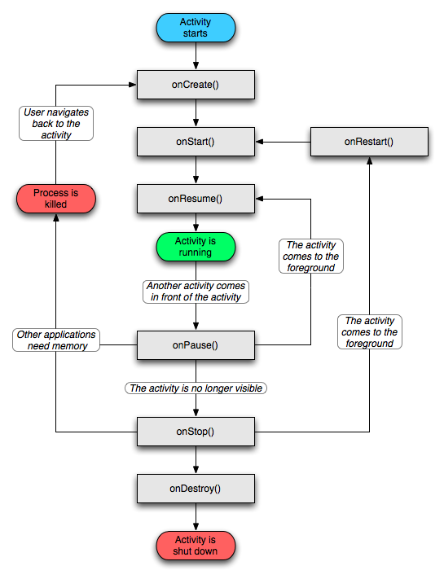
Android Life Cycle

Slide 15
Management
Most management of the life cycle is done automatically by the system via the activity stack.
The activity class has the following method callbacks to help you manage the app:
onCreate()
onStart()
onResume()
onPause()
onStop()
onRestart()
onDestroy()

Slide 16
onCreate()
You must implement this callback, which fires when the system first creates the activity. On activity creation, the activity enters the Created state.
In the onCreate() method, you perform basic application startup logic that should happen only once for the entire life of the activity.
For example, your implementation of onCreate() might bind data to lists, initialize background threads, and instantiate some class-scope variables.
This method receives the parameter savedInstanceState, which is a Bundle object containing the activity's previously saved state.
If the activity has never existed before, the value of the Bundle object is null

Slide 17
onStart()
When the activity enters the Started state, the system invokes this callback. The onStart() call makes the activity visible to the user, as the app prepares for the activity to enter the foreground and become interactive.
For example, this method is where the app initializes the code that maintains the UI.
It might also register a BroadcastReceiver that monitors changes that are reflected in the UI.
The onStart() method completes very quickly and, as with the Created state, the activity does not stay resident in the Started state.
Once this callback finishes, the activity enters the Resumed state, and the system invokes the onResume() method.

Slide 18
onResume()
When the activity enters the Resumed state, it comes to the foreground, and then the system invokes the onResume() callback.
This is the state in which the app interacts with the user. The app stays in this state until something happens to take focus away from the app.
Such an event might be, for instance, receiving a phone call, the user’s navigating to another activity, or the device screen’s turning off.
When an interruptive event occurs, the activity enters the Paused state, and the system invokes the onPause() callback.

Slide 19
onPause()
The system calls this method as the first indication that the user is leaving your activity (though it does not always mean the activity is being destroyed).
Use the onPause() method to pause operations such animations and music playback that should not continue while the Activity is in the Paused state, and that you expect to resume shortly. There are several reasons why an activity may enter this state. For example:
Some event interrupts app execution. This is the most common cause.
In Android 7.0 (API Level 24) or higher, multiple apps run in multi-window mode. Because only one app has focus at any time, the system pauses all of the other apps
A new, semi transparent activity(such as dialog) opens

Slide 20
onStop()
When your activity is no longer visible to the user, it has entered the Stopped state, and the system invokes the onStop() callback. This may occur, for example, when a newly launched activity covers the entire screen. The system may also call onStop() when the activity has finished running, and is about to be terminated.
In the onStop() method, the app should release almost all resources that aren't needed while the user is not using it. For example, if you registered a BroadcastReceiver in onStart() to listen for changes that might affect your UI, you can unregister the broadcast receiver in onStop(), as the user can no longer see the UI.
It is also important that you use onStop() to release resources that might leak memory, because it is possible for the system to kill the process hosting your activity without calling the activity's final onDestroy() callback.
You should also use onStop() to perform relatively CPU-intensive shutdown operations. For example, if you can't find a more opportune time to save information to a database, you might do so during onStop().

Slide 21
onDestroy()
Called before the activity is destroyed. This is the final call that the activity receives. The system either invokes this callback because the activity is finishing due to someone's calling finish(), or because the system is temporarily destroying the process containing the activity to save space.
You can distinguish between these two scenarios with the isFinishing() method.The system may also call this method when an orientation change occurs, and then immediately call onCreate() to recreate the process (and the components that it contains) in the new orientation.
The onDestroy() callback releases all resources that have not yet been released by earlier callbacks such as onStop().

Slide 22
Program LifeCycle
Start New Android Studio Project
In configure your project window, fill out the following
Application Name: LifeCycle
Company Domain: write whatever you want
Project Location: Leave as default
In target Android Devices, pick the Minimum SDK as Gingerbread
In the activity window, pick the Empty Activity
In the customize Activity window, fill Activity Name as MainActivity and leave as default one

Slide 23
activity_main.xml
<RelativeLayout xmlns:android="http://schemas.android.com/apk/res/android"
xmlns:tools="http://schemas.android.com/tools"
android:layout_width="match_parent"
android:layout_height="match_parent"
android:paddingBottom="@dimen/activity_vertical_margin"
android:paddingLeft="@dimen/activity_horizontal_margin"
android:paddingRight="@dimen/activity_horizontal_margin"
android:paddingTop="@dimen/activity_vertical_margin"
tools:context=".MainActivity" >
<TextView
android:layout_width="wrap_content"
android:layout_height="wrap_content"
android:text="@string/hello_world" />
</RelativeLayout>

Slide 24
MainActivity.java
package com.wilis.lifecycle;
import android.os.Bundle;
import android.app.Activity;
import android.view.Menu;
import android.widget.Toast;
public class MainActivity extends Activity {
@Override
protected void onDestroy() {
// TODO Auto-generated method stub
super.onDestroy();
Toast.makeText(this,"App onDestroy",Toast.LENGTH_SHORT).show();
}

Slide 25
MainActivity.java
@Override
protected void onPause() {
// TODO Auto-generated method stub
super.onPause();
Toast.makeText(this,"App onPause",Toast.LENGTH_SHORT).show();
}
@Override
protected void onRestart() {
// TODO Auto-generated method stub
super.onRestart();
Toast.makeText(this,"App onRestart",Toast.LENGTH_SHORT).show();
}

Slide 26
MainActivity.java
@Override
protected void onResume() {
// TODO Auto-generated method stub
super.onResume();
Toast.makeText(this,"App onResume",Toast.LENGTH_SHORT).show();
}
@Override
protected void onStart() {
// TODO Auto-generated method stub
super.onStart();
Toast.makeText(this,"App onStart",Toast.LENGTH_SHORT).show();
}

Slide 27
MainActivity.java
@Override
protected void onCreate(Bundle savedInstanceState) {
super.onCreate(savedInstanceState);
setContentView(R.layout.activity_main);
}
@Override
public boolean onCreateOptionsMenu(Menu menu) {
// Inflate the menu; this adds items to the action bar if it is present.
getMenuInflater().inflate(R.menu.main, menu);
return true;
}
}

